Slide 1
Tilemaps
Software Studio 軟體設計與實驗
Hung-Kuo Chu
Department of Computer Science
National Tsing Hua University
CS2410

Slide 2
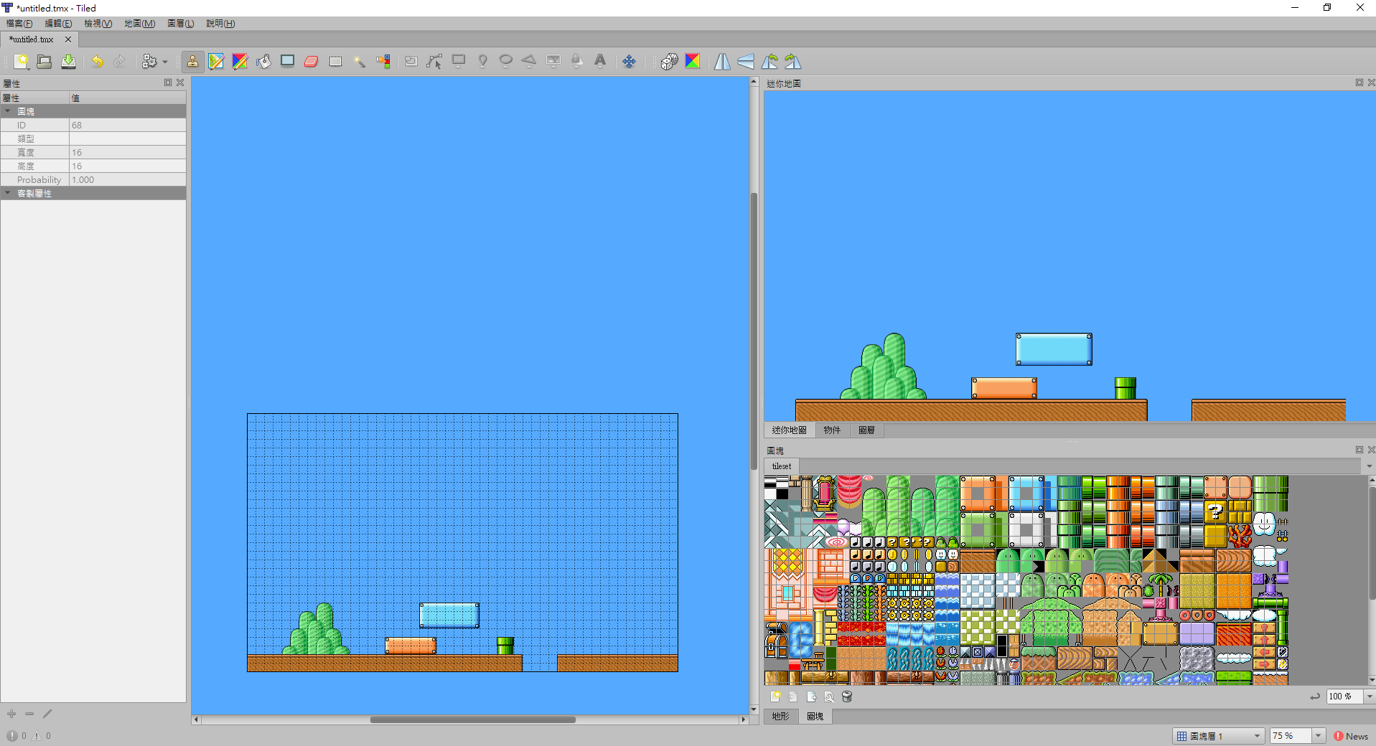
Tilemaps
In the earlier chapter we created the level manually by adding walls one by one.
It works, but creating a world can be easier with tilemaps.
‘Tiles’, a well known world editor

Slide 3
Tilemaps
Here are some basic definitions about tilemaps:
Tile: a small image that represents a tiny part of a level.
Tileset: a spritesheet that contains all the different tiles.
Tilemap: the level, stored as a 2 dimensional array of tiles.

Slide 4
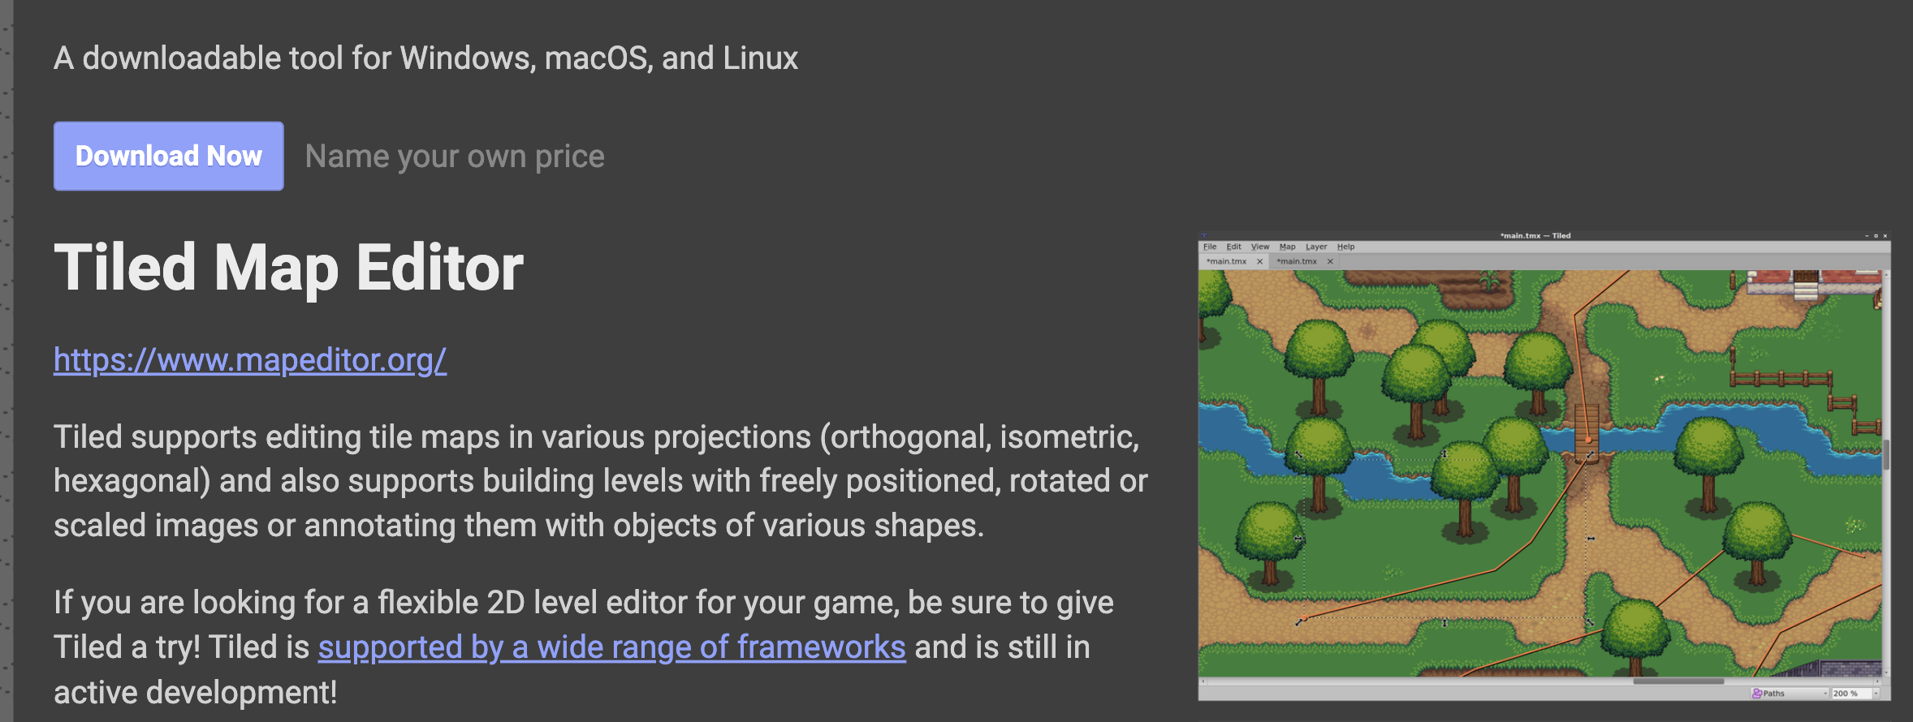
Tiled: A World Editor
There are a lot of software available to create tilemaps, ‘Tiled’ is one of the most popular editor.
It’s free, open source, and cross platform.

Slide 5

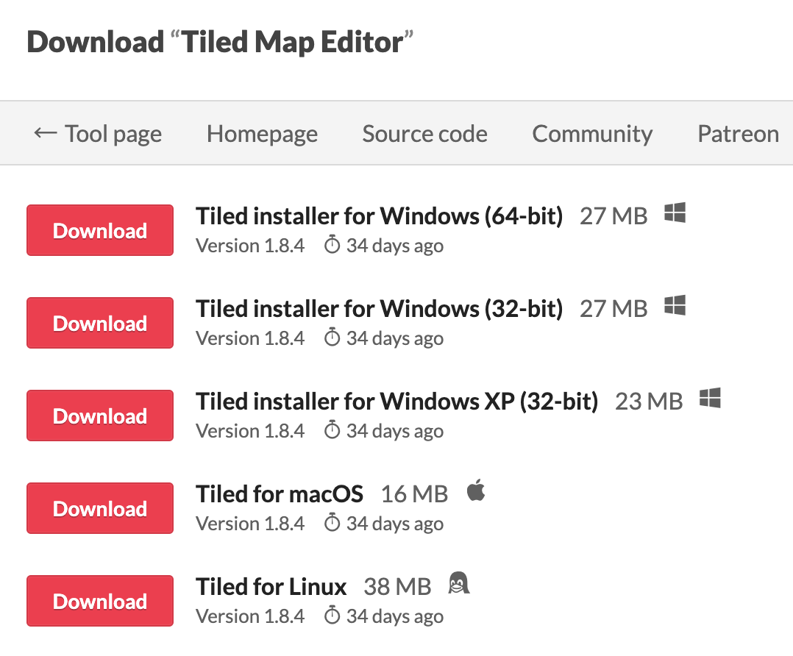
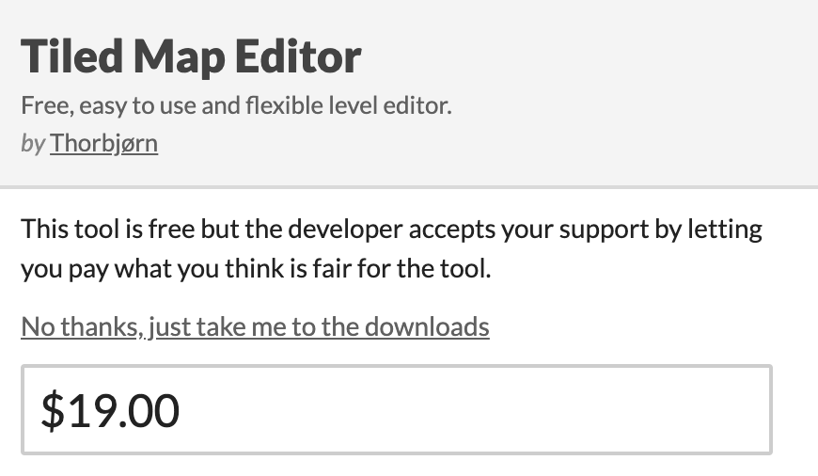
Tiled: A World Editor
Download Tiled :
1. Click “Download Now”
3. Download
2. Click “No thanks”

Slide 6
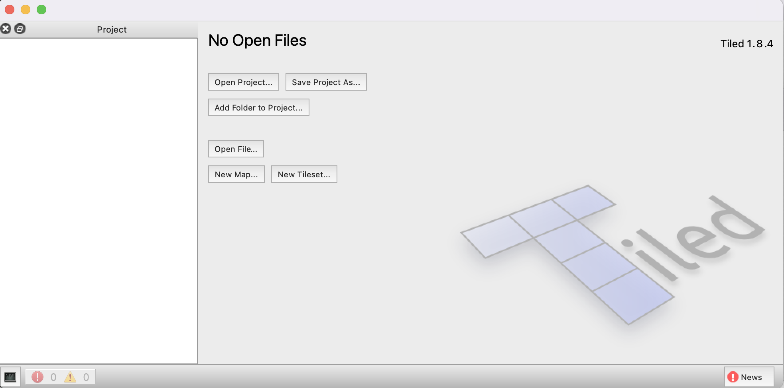
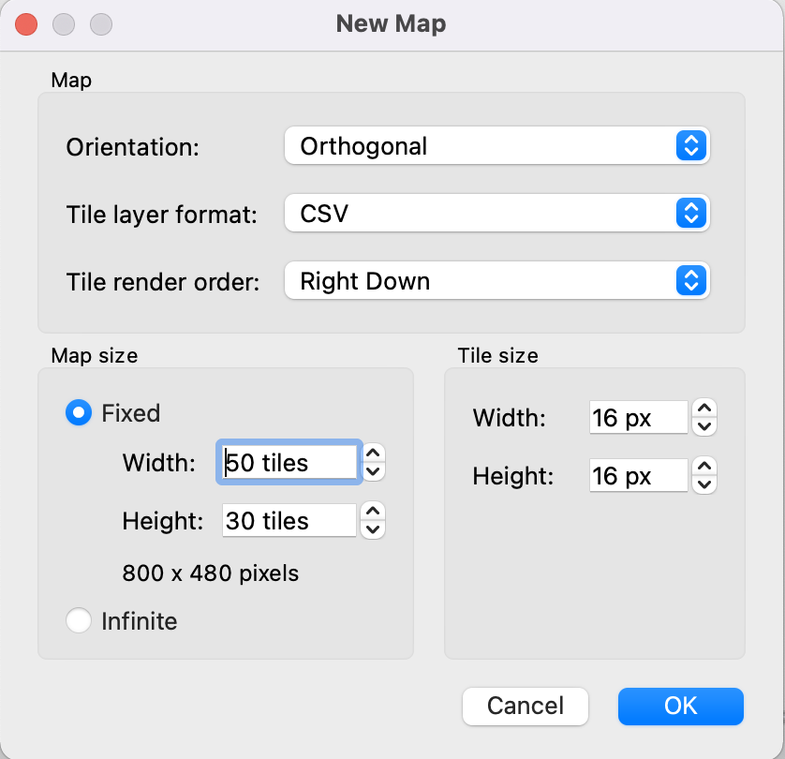
Tiled: A World Editor
Open Tiled, do New Map, and fill the form like this to create an empty tilemap.
1. Open Tiled
3. Set up tilemap
2. New Map

Slide 7
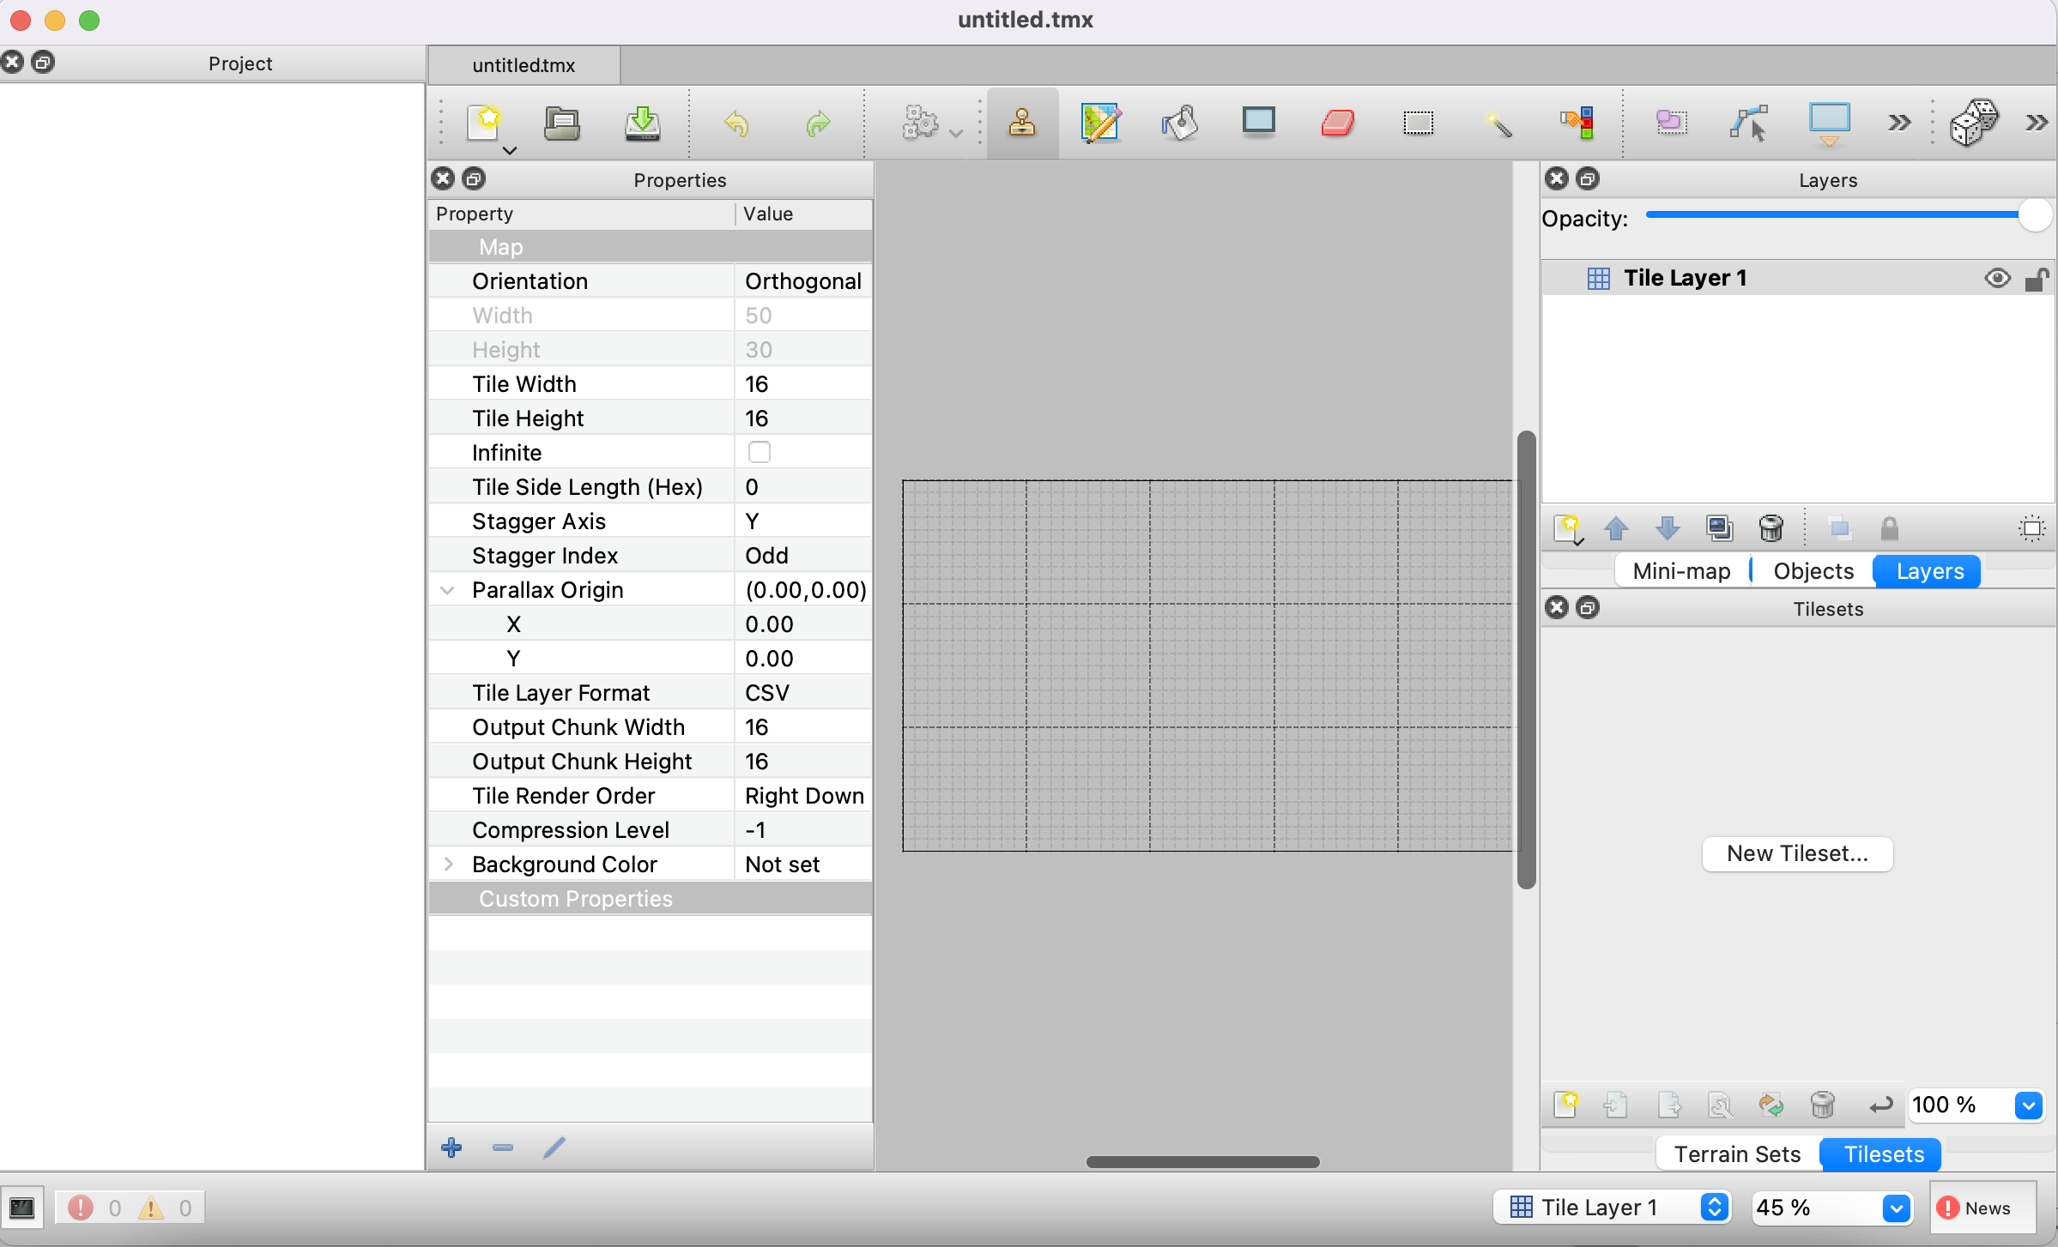
Tiled: A World Editor
Click New Tileset to create a new tileset

Slide 8
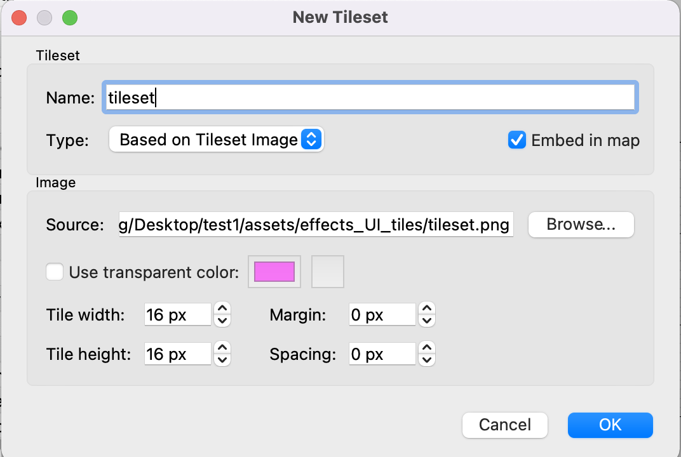
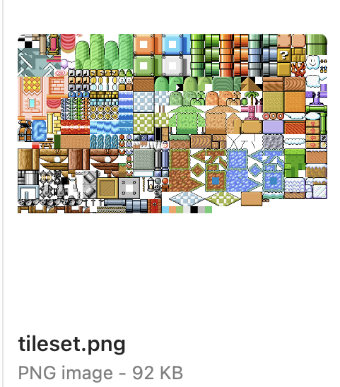
Tiled: A World Editor
And fill the form to create tileset
1. Check embed in map
2. Choose the tileset
3.

Slide 9
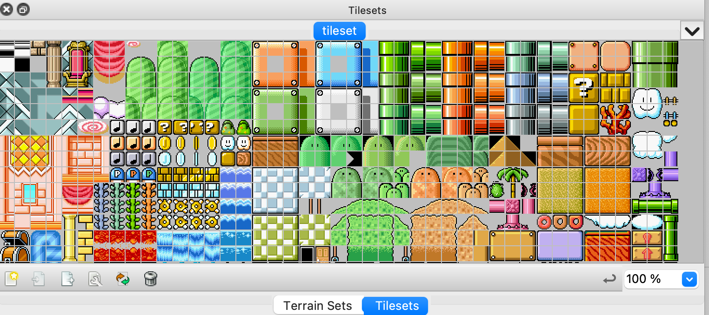
Tiled: A World Editor
Now we can see our tileset

Slide 10
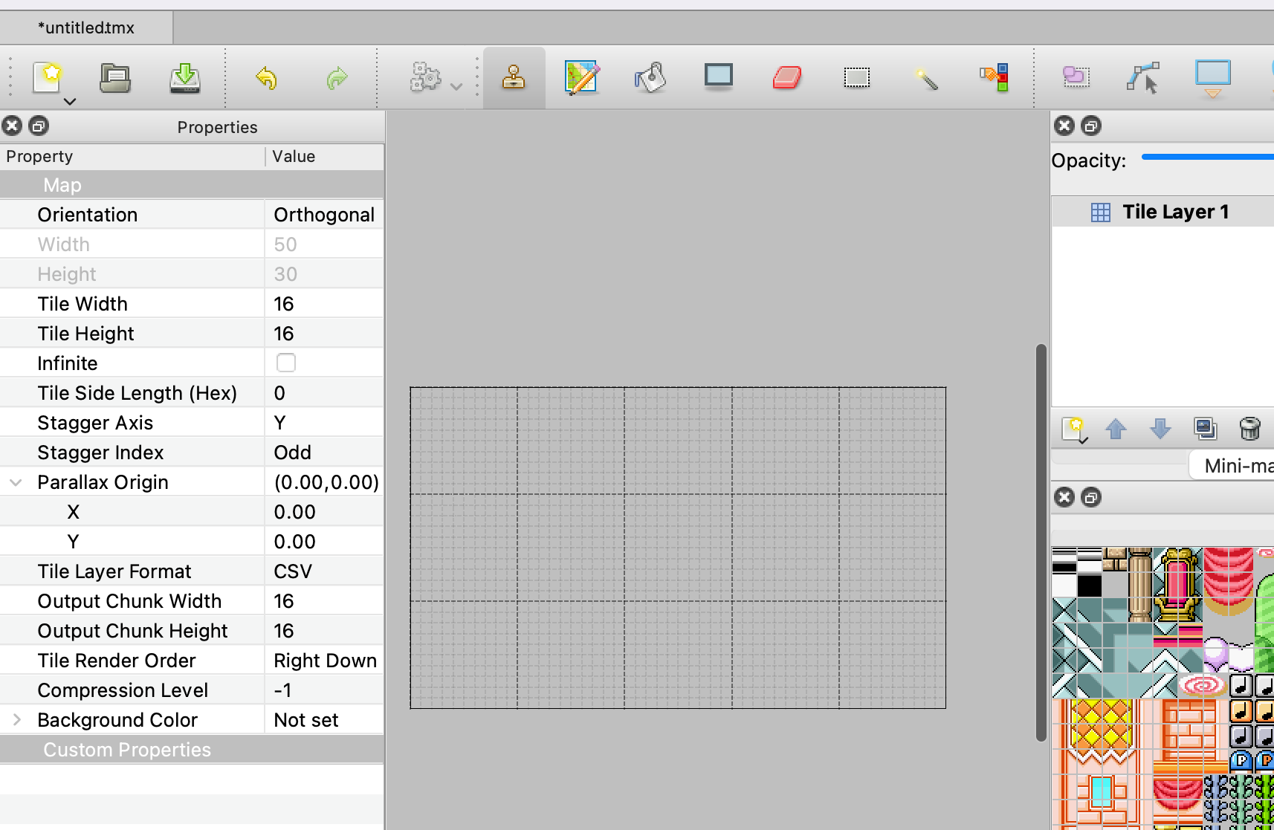
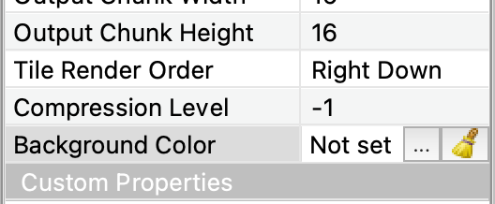
Tiled: A World Editor
Set background color with
“map → map properties”
Click and choose a color

Slide 11
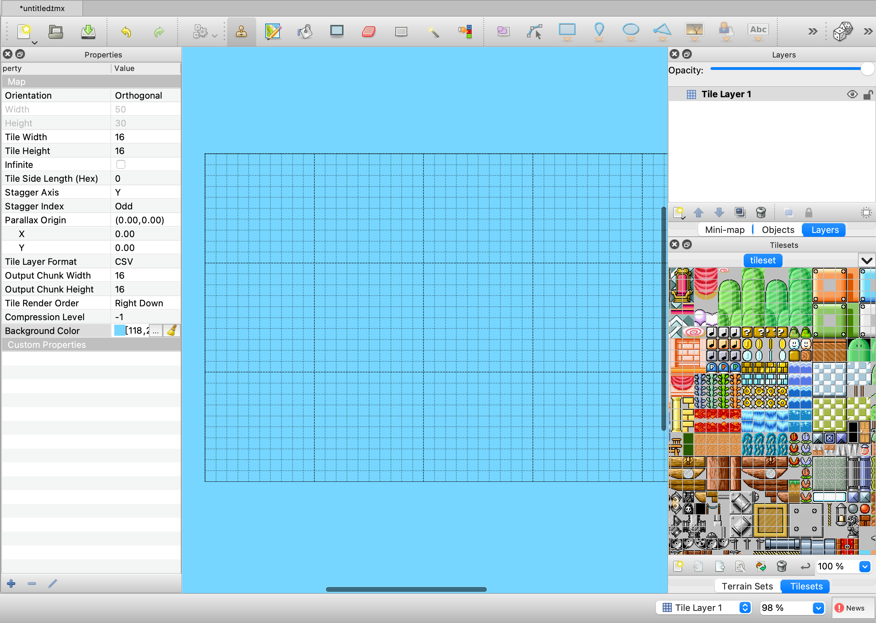
Tiled: A World Editor
Current layer
This is our current empty map

Slide 12
Tiled: A World Editor
The empty tilemap is now properly set up, the next step is to design the level.
For this we will need 2 tools: the stamp to draw tiles on the map and the eraser to remove tiles.

Slide 13
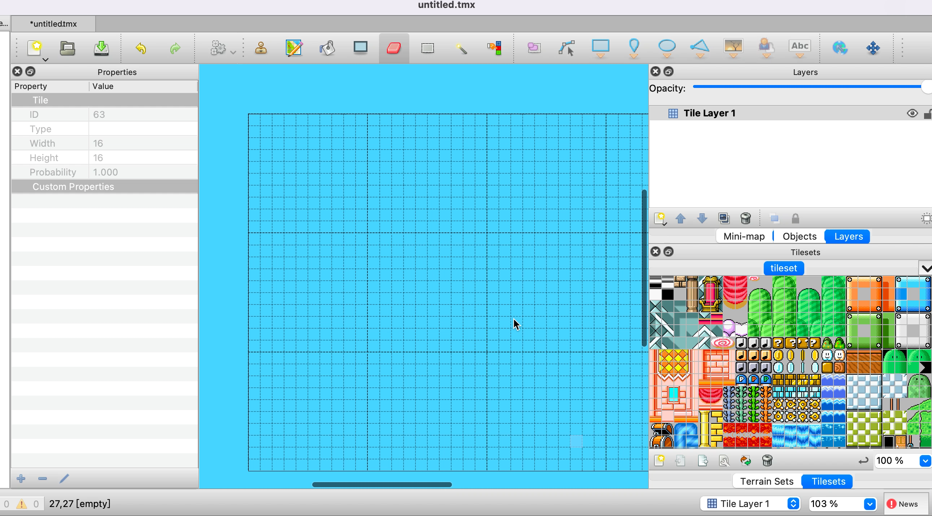
Tiled: A World Editor
And now simply draw a level using the tileset in the bottom right corner.

Slide 14
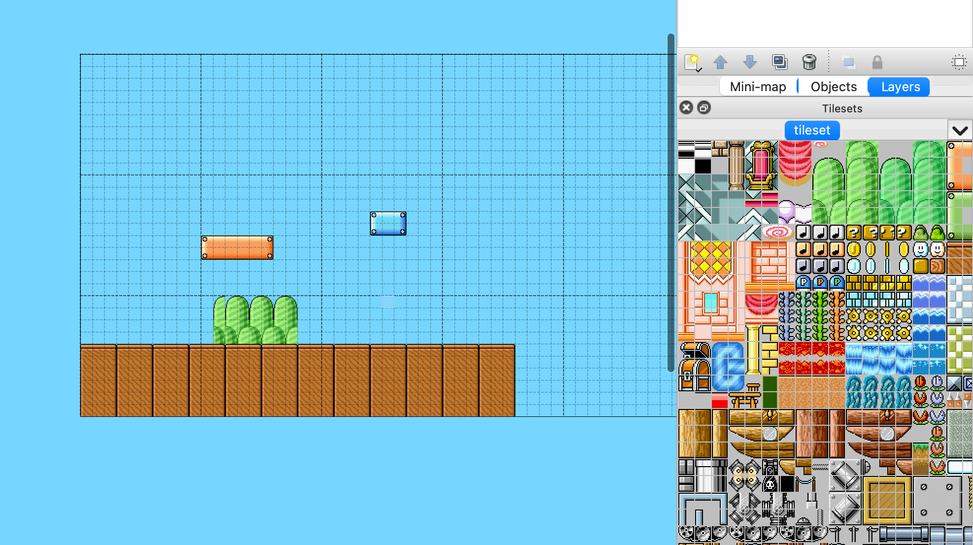
Tiled: A World Editor
With tileset, you can easily paint your world map.

Slide 15
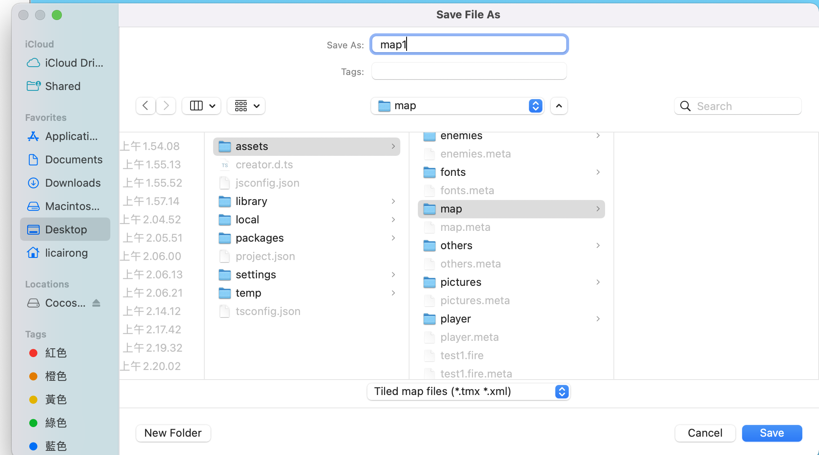
Save tilemap to Cocos creator
Save the file to CocosCreator project directly!
Project folder -> assets -> map -> save !

Slide 16
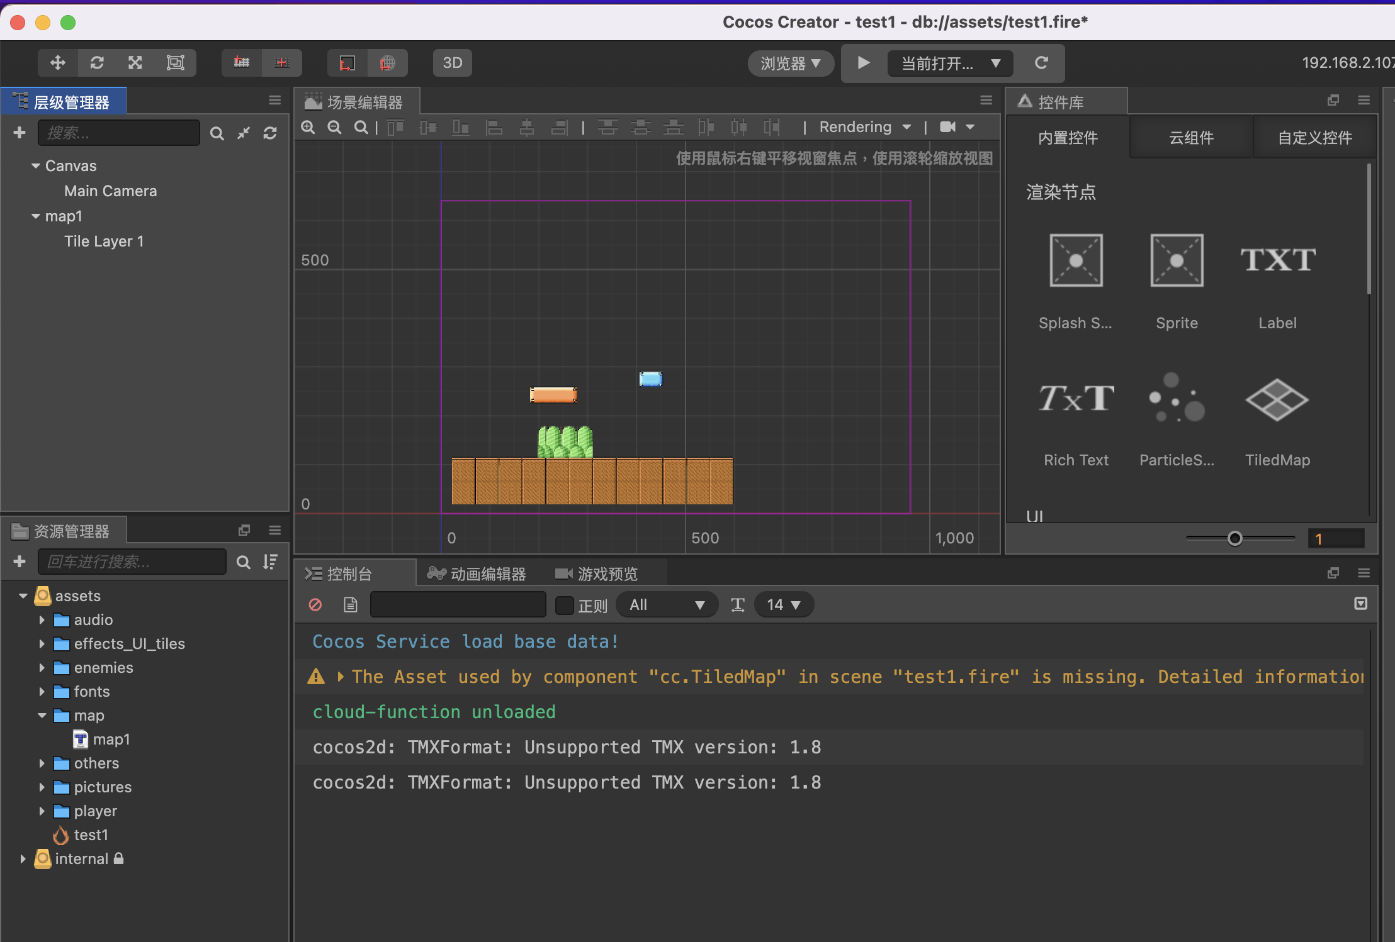
Use your map
In CocosCreator, use your map by directly drag it into your scene!
2. The map object will be created
1. Drag into the scene!

Slide 17





